Slide 1
MULTIPLE LINEAR REGRESSION USING PYTHON

Slide 2
Multiple Linear Regression: Recap
Multiple linear regression is used to explain the relationship between one continuous dependent variable and two or more independent variables.
The independent variables can be continuous or categorical.
Multiple Linear Regression is used when we want to predict the value of a variable based on the values of two or more other variables.
The variable we want to predict is called the dependent variable
The variables used to predict the value of dependent variable are called independent variables (or explanatory variables/predictors).
Multiple linear regression requires the model to be linear in the parameters.
Example: The price house in USD can be dependent variable and area of house, location of house , air quality index in the area, distance from airport etc. can be independent variables.

Slide 3

Statistical Model
$$Y= b_{0}+b_{1}X_{1}+b_{2}X_{2}+ … +b_{p}X_{p}+e$$
where,
Y : Dependent Variable
X₁, X₂ ,…, X_{p} : Independent Variables
b₀, b₁ ,…, b_{p} : Parameters of Model
e : Random Error Component
Independent variables can either be Continuous or Categorical
Multiple linear regression requires the model to be linear in the parameters
Parameters of the model are estimated by Least Square Method.
The least squares (LS) criterion states that the sum of the squares of errors (or residuals) is minimum.
Mathematically, following quantity is minimized to estimate parameters using least square method.
^
Error ss= Σ (Yi – Yi )2

Slide 4
Case Study – Modeling Job Performance Index
Background
Objective
Available Information
A company conducts different written tests before recruiting employees. The company wishes to see if the scores of these tests have any relation with post-recruitment performance of those employees.
To predict employees’ job performance index after probationary period, based on scores of tests conducted at the time of recruitment
Independent Variables: Scores of tests conducted before recruitment on the basis of four criteria – Aptitude, Test of Language, Technical Knowledge, General Information
Sample size is 33
Dependent Variable: Job Performance Index calculated after an employee finishes probationary period (6 months)

Slide 5
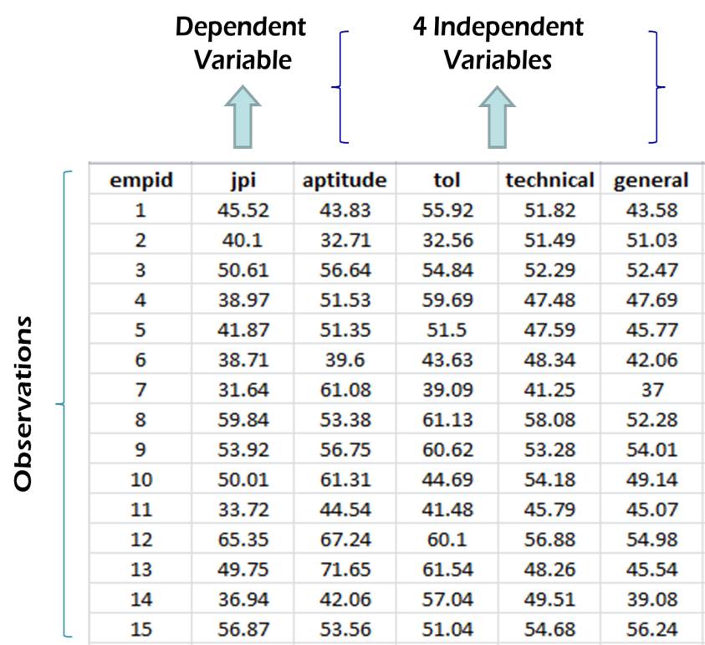
Data Snapshot
Performance Index
Columns | Description | Type | Measurement | Possible values
empid | Employee ID | integer | - | -
jpi | Job performance Index | numeric | - | positive values
aptitude | Aptitude score | numeric | - | positive values
tol | Test of Language | numeric | - | positive values
technical | Technical Knowledge | numeric | - | positive values
general | General Information | numeric | - | positive values

Slide 6
Graphical Representation of Data
It is always recommended to have a general look at your data and behavior of all the variables before moving to modeling.
This helps you in making intuitive inferences about the data, which can be statistically validated by your final model.
The simplest way of doing this is creating a scatter plot matrix, which will give bivariate relationships between variables.
#Importing the Data
import pandas as pd perindex = pd.read_csv("Performance Index.csv")
#Graphical Representation of the Data
import seaborn as sns sns.pairplot(perindex)

Slide 7
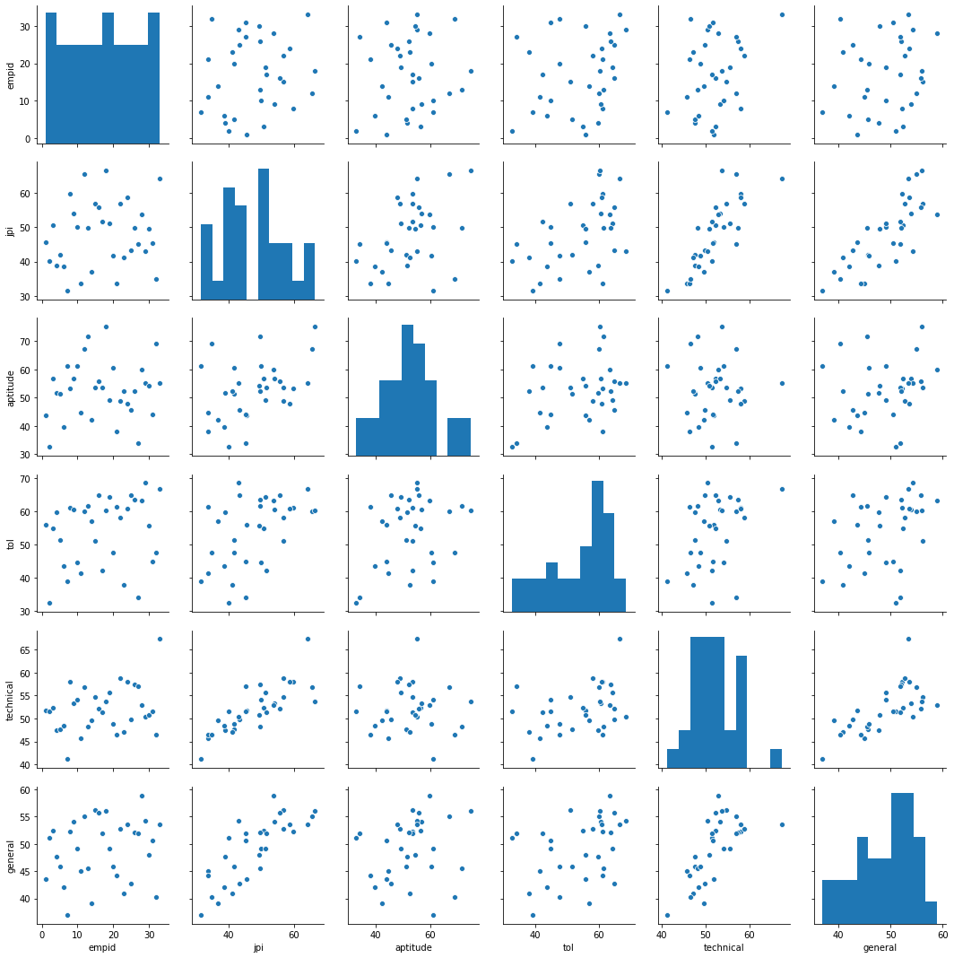
Scatter Plot Matrix
pairplot() function in library seaborn gives scatter plot matrix and distribution of all variables using histogram.

Slide 8
Model for the Case Study
Dependent Variable
Independent Variables
jpi = b₀ + b₁(aptitude) + b₂(tol) + b₃(technical) + b₄(general) + e
Parameter Estimates
Intercept / Constant
Error Term

Slide 9
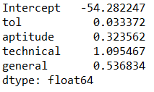
Parameter Estimation Using ols() function in Python
#Model Fit
import statsmodels.formula.api as smf jpimodel=smf.ols('jpi ~ tol + aptitude + technical +general', data=perindex).fit() jpimodel.params
ols() fits a linear regression.
~ separates dependent and independent variables
Left hand side of tilde(~) represents the dependent variable and right-hand side shows independent variables
+ separates multiple independent variables.
#Output
Interpretation :
jpimodel.params gives the model parameters.
Signs of each parameter represent their relationship with the dependent variable.

Slide 10
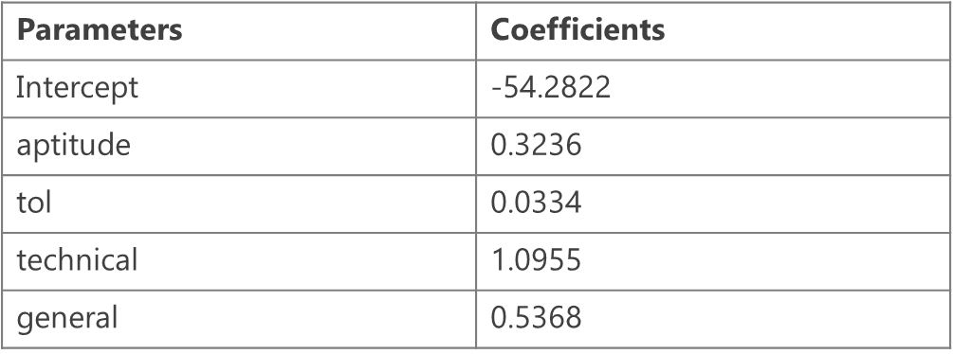
Interpretation of Partial Regression Coefficients
For every unit increase in the independent variable (X), expected value of the dependent variable (Y) will change by the corresponding parameter estimate (b), keeping all the other variables constant
From the parameter estimates table, we observe that the parameter estimate for Aptitude Test is 0.3236
We can infer that for one unit increase in aptitude test score, the expected value of job performance index will increase by 0.3236 units

Slide 11



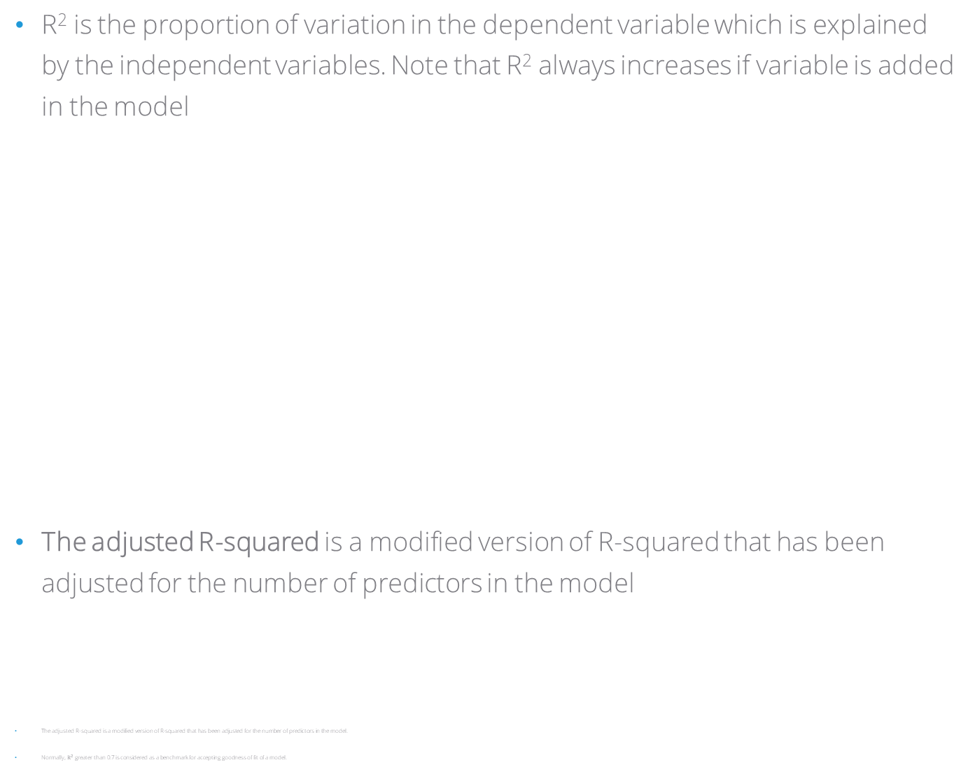

Measure of Goodness of Fit – R Squared
R² is the proportion of variation in the dependent variable which is explained by the independent variables. Note that R² always increases if variable is added in the model
The adjusted R-squared is a modified version of R-squared that has been adjusted for the number of predictors in the model
The adjusted R-squared is a modified version of R-squared that has been adjusted for the number of predictors in the model.
Normally, $R^{2}$ greater than 0.7 is considered as a benchmark for accepting goodness of fit of a model.
$$\sum_{i=1}^{n}{\left(\hat{Y}i −\overline{Y}\right)}2$$
$$R^{2}=\frac{Explained Variation}{Total Variation}$$
$$=$$
$$\sum_{i=1}^{n}{\left(Yi −\overline{Y}\right)}2$$

Slide 12
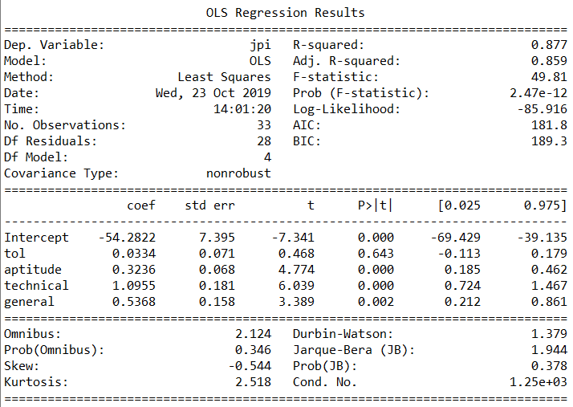
Understanding Summary Output
#Model Summary
jpimodel.summary()
summary() generates a detailed description of the model.
Interpretation :
Reject Global Testing null hypothesis that no variables are significant as p-value is<0.05
Intercept, aptitude, technical, general are significant variables (p-values<0.05)
tol is not significant (p-value>0.05)

Slide 13
Summary of Findings
Significant variables
Aptitude
Technical knowledge
General information
Out of four dependent variables, three affect job performance index positively
R²
0.88
88% of the variation in job performance index is explained by the model & 12% is unexplained variation

Slide 14
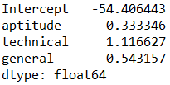
Fitted Values and Residuals
#Model Fitting after eliminating the insignificant variable
jpimodel_new=smf.ols('jpi ~ aptitude + technical +general', data=perindex).fit() jpimodel_new.params
The insignificant variable tol is not included in the new model
#Output
Estimated values of the model parameters using the new model
*
To get the fitted values and the residuals values, the model should include only the significant variables

Slide 15
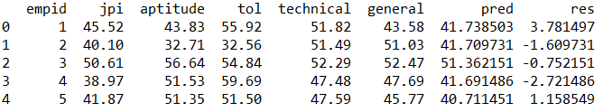
Fitted Values and Residuals
#Adding Fitted Values and Residuals to the Original Dataset
perindex=perindex.assign(pred=pd.Series(jpimodel_new.fittedvalues)) perindex=perindex.assign(res=pd.Series(jpimodel_new.resid)) perindex.head()
fittedvalues() and resid() fetch fitted values and residuals respectively.
#Output
Interpretation :
pred values are calculated based on the values of the model parameters
res is the difference between the actual jpi values and the pred values.
Lower the residuals, lesser is the difference between fitted and observed and better is the model.

Slide 16
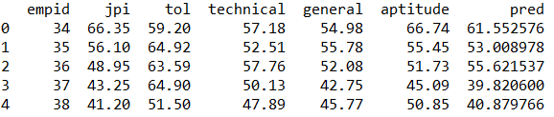
Predictions for New Dataset
New data set should have all the independent variables used in the model
Column names of all common variables in the new and old datasets should be identical
Note that missing values will be taken as 0 (which can be incorrect)
#Importing New Dataset
perindex_new=pd.read_csv("Performance Index new.csv") perindex_new=perindex_new.assign(pred=pd.Series(jpimodel_new.predict(perindex_new))) perindex_new.head()
predict() returns predicted values. Fitted model is the first argument and new dataset object is the second argument. This ensures Python uses parameters from the fitted model for predictions on new data.

Slide 17
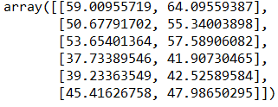
Predictions with Confidence Interval
#Predictions with Confidence Interval
result = jpimodel_new.get_prediction(perindex_new) result.conf_int()
conf_int() generates 95% confidence intervals by default.
Left hand side values in array gives lower confidence interval values, right gives upper.
#Output
Q. Why are confidence intervals needed for predictions?
A. The point estimate is the best guess of the true value of the parameter, while the interval estimate gives a measure of accuracy of that point estimate by providing an interval that contains plausible values.
*
If you wish to specify the level of tolerance/confidence, use alpha= argument in the conf_int() function. For example, to calculate 90% confidence intervals, alpha = 0.1

Slide 18
THANK YOU!!

